Slide 1
Set reference documentation
1/13/2010

Slide 2
Notes
The one piece of documentation that cannot be seen in the video is the ability to switch between spectra using the up and down arrows.

Slide 3
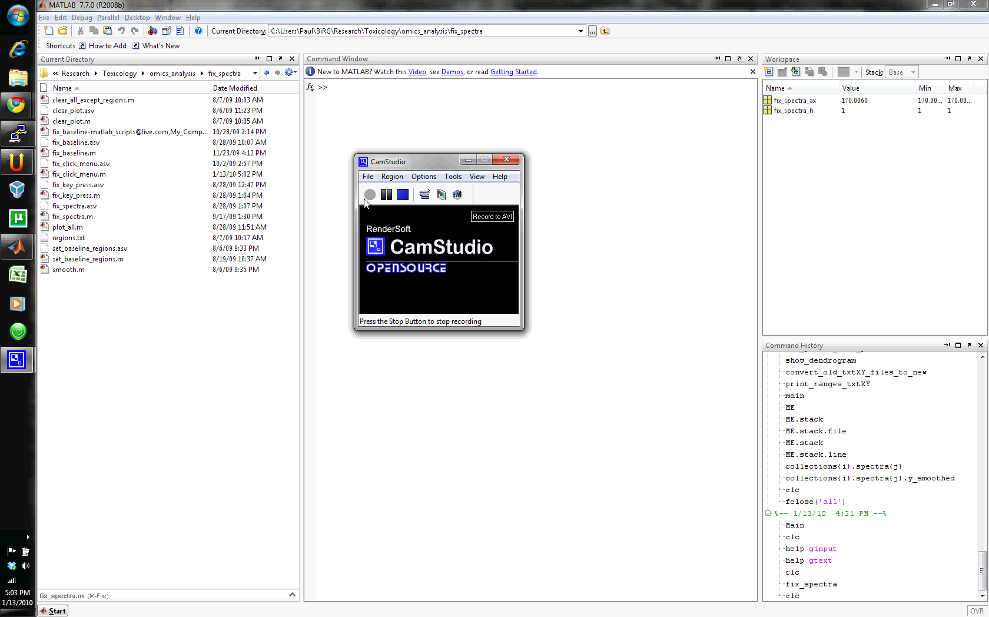
Click to start

